Slide 1
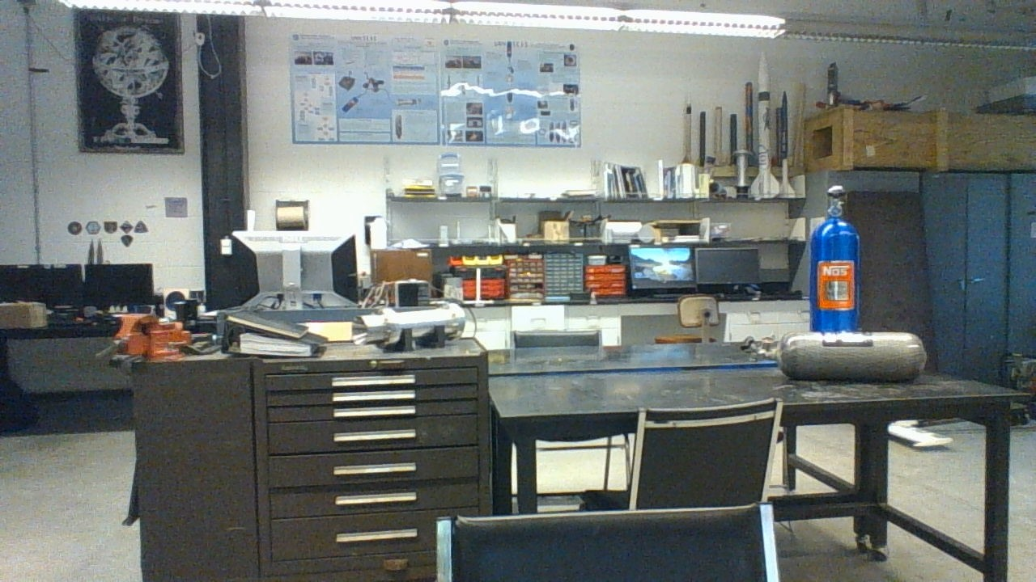
Thomas Collins
MIFP Interview Trinket Explanation
Notes:
Silas

Slide 2
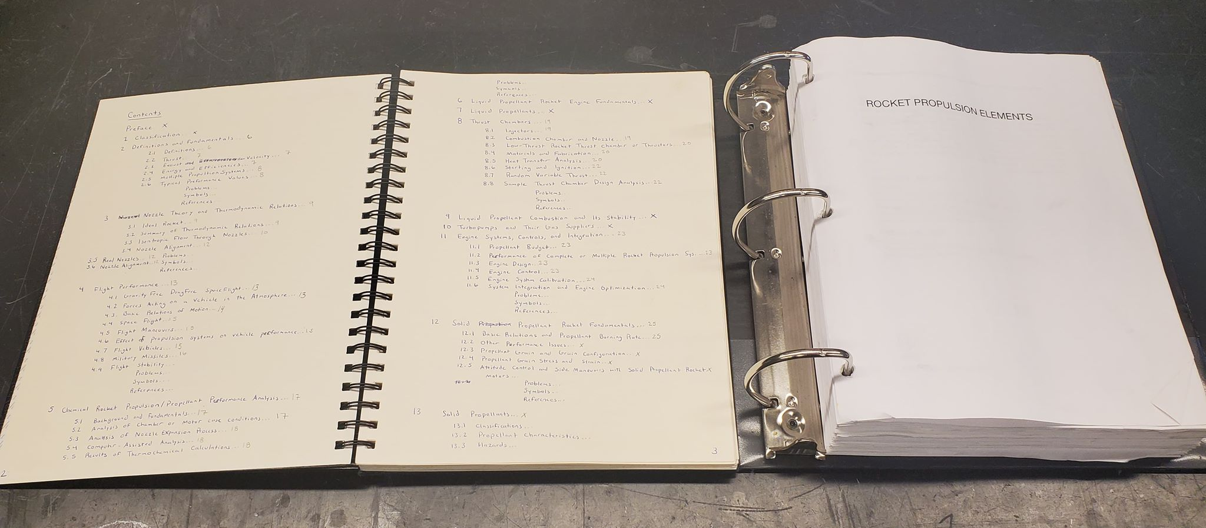
Rocket Propulsion Elements
In August 2018, Charlie Nitschelm and I summarized Rocket Propulsion Elements by George Paul Sutton and Oscar Biblarz. We felt this knowledge was critical to the next phase of UNH SEDS and the development of our hybrid engine. This summary consisted of the selected chapters most related to our organization and took about 3 weeks to complete.
Notes:
everyone

Slide 3
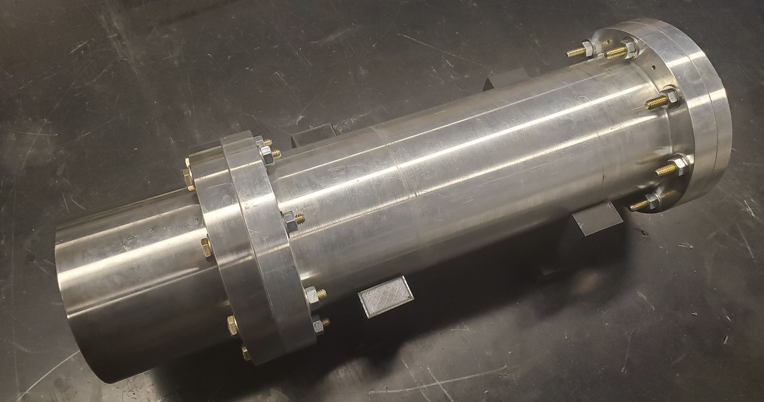
Project RUNAWAY
Project RUNAWAY was developed initially during the 2018-2019 school year. With a group of 6 Mechanical Engineering seniors and the preexisting members of UNH SEDS, we hot fire tested the engine 4 times. Personally, I directed 2 of these hot fire tests and assisted the senior team in the design and analysis of our engine. The cold and hot fire tests are showcased on our website along with additional information on the project.
Notes:
everyone

Slide 4
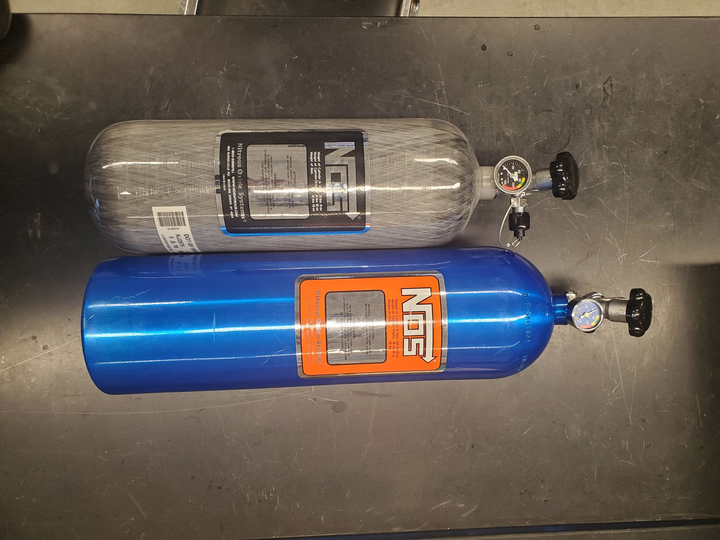
Nitrous Oxide Tanks
Although a commercial off the shelf part, these bottles represent UNH SEDS’ growth over the past few years. Our fundraising efforts have rewarded us with an oxidizer tank that is lighter and more compact. This advantage comes in the form of a 12 lbs. 4 oz reduction in total weight while only sacrificing 3 lbs. 3 oz of oxidizer. The blue Nitrous tank will remain our hot fire testing tank with the Carbon Fiber wrapped tank being used in our final rocket. As the lead frame engineer, any reduction in weight to our rocket and motivating the team to raise these funds was critical.
Notes:
everyone

Slide 5

Thank you for everything!
Below are UNH SEDS’ social media links.
Website
https://www.unhseds.org
YouTube
https://www.youtube.com/channel/UCCGet3NkAJHD2hr-q8MuCUg
Instagram
https://www.instagram.com/unhseds/
Facebook
https://www.facebook.com/UNHSEDS/
LinkedIn
https://www.linkedin.com/company/unh-students-for-the-exploration-and-development-of-space-seds/?viewAsMember=true
Notes:
everyone

